Slide 1
The Letter to the Ephesians
Immeasurably More
Power
Now to him who is able to do immeasurably more than all we ask or imagine…

Slide 2
For this reason I, Paul, the prisoner of Christ Jesus for the sake of you Gentiles –
² Surely you have heard about the administration of God’s grace that was given to me for you, ³ that is, the mystery made known to me by revelation, as I have already written briefly. ⁴ In reading this, then, you will be able to understand my insight into the mystery of Christ, ⁵ which was not made known to people in other generations as it has now been revealed by the Spirit to God’s holy apostles and prophets. ⁶ This mystery is that through the gospel the Gentiles are heirs together with Israel, members together of one body, and sharers together in the promise in Christ Jesus.

Slide 3
⁷ I became a servant of this gospel by the gift of God’s grace given me through the working of his power. ⁸ Although I am less than the least of all the Lord’s people, this grace was given me: to preach to the Gentiles the boundless riches of Christ, ⁹ and to make plain to everyone the administration of this mystery, which for ages past was kept hidden in God, who created all things. ¹⁰ His intent was that now, through the church, the manifold wisdom of God should be made known to the rulers and authorities in the heavenly realms, ¹¹ according to his eternal purpose that he accomplished in Christ Jesus our Lord. ¹² In him and through faith in him we may approach God with freedom and confidence. ¹³ I ask you, therefore, not to be discouraged because of my sufferings for you, which are your glory.

Slide 4
¹⁴ For this reason I kneel before the Father, ¹⁵ from whom every family^{[a]} in heaven and on earth derives its name. ¹⁶ I pray that out of his glorious riches he may strengthen you with power through his Spirit in your inner being, ¹⁷ so that Christ may dwell in your hearts through faith. And I pray that you, being rooted and established in love, ¹⁸ may have power, together with all the Lord’s holy people, to grasp how wide and long and high and deep is the love of Christ, ¹⁹ and to know this love that surpasses knowledge – that you may be filled to the measure of all the fullness of God.

Slide 5
²⁰ Now to him who is able to do immeasurably more than all we ask or imagine, according to his power that is at work within us, ²¹ to him be glory in the church and in Christ Jesus throughout all generations, for ever and ever! Amen.

Slide 7
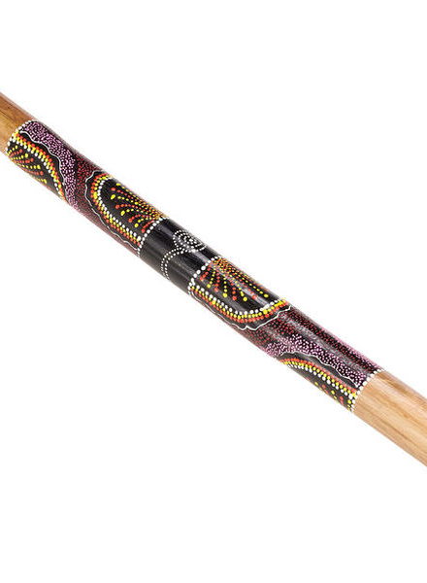

Slide 8
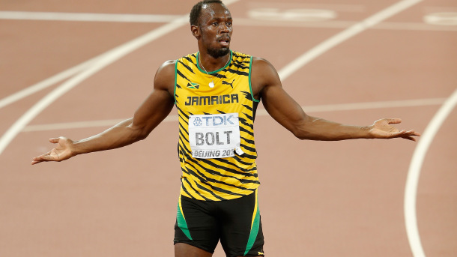

Slide 9
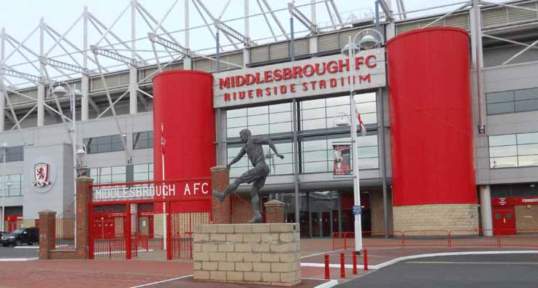
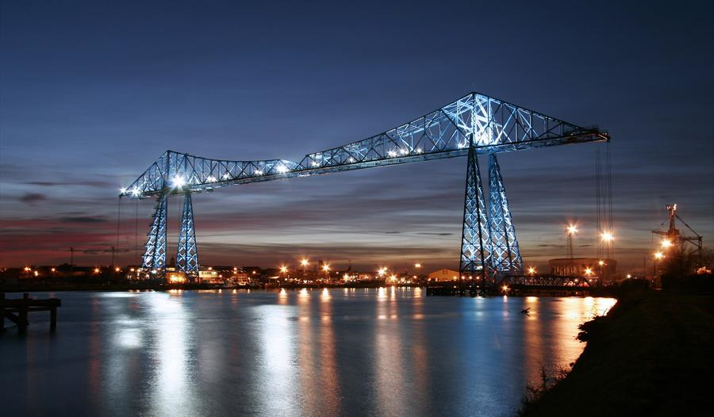
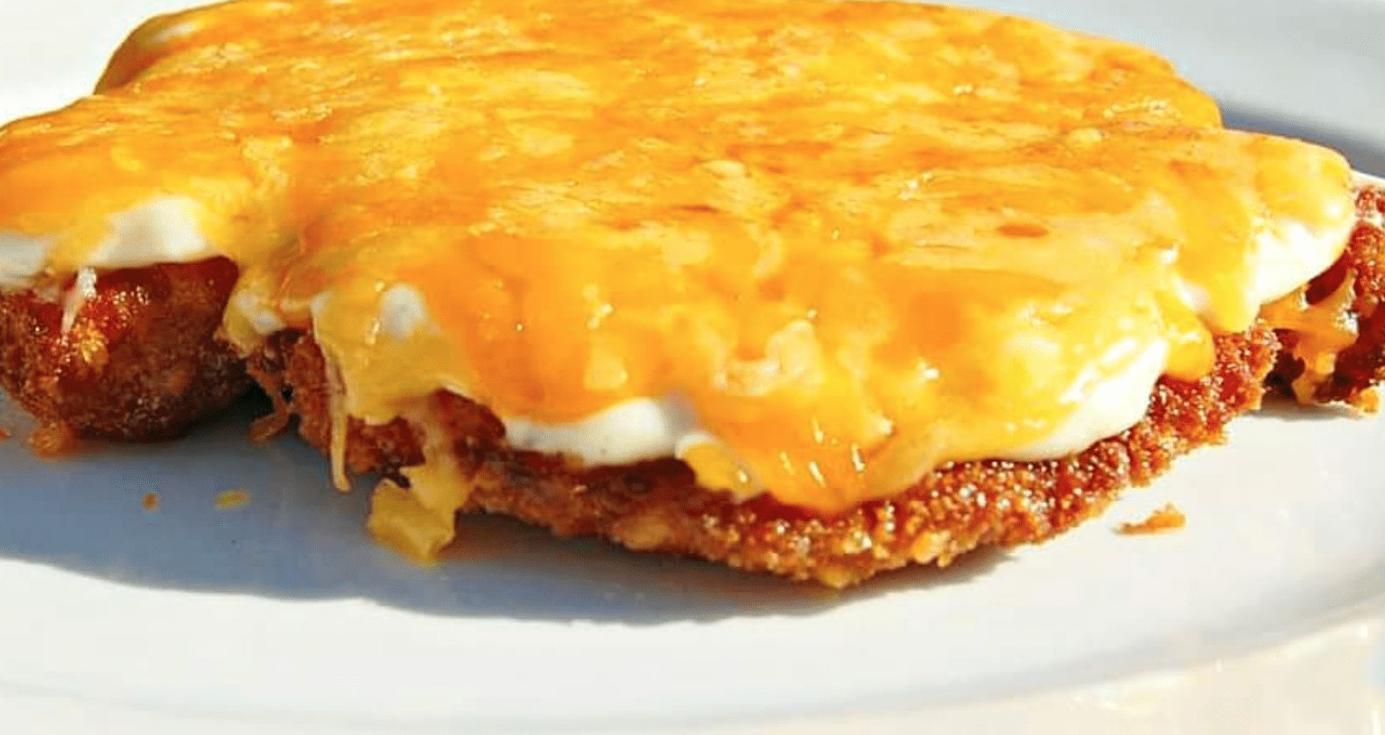

Slide 10
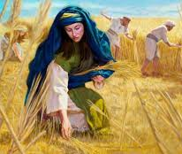
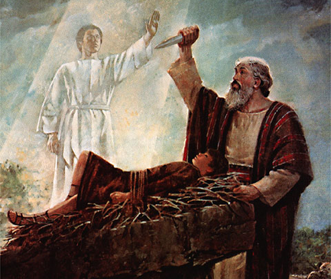
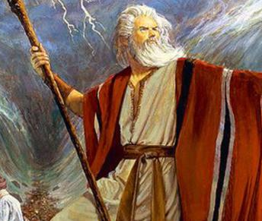
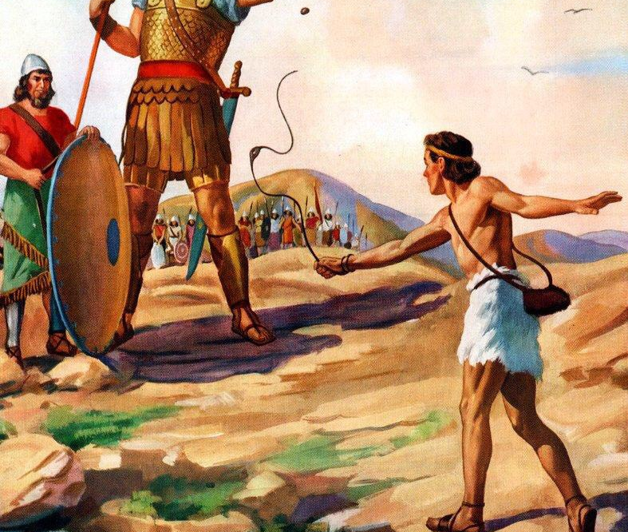
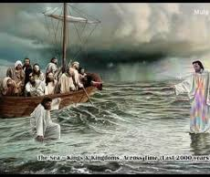
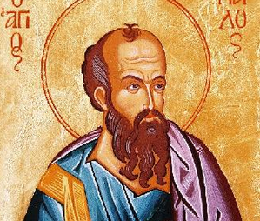

Slide 12
Immeasurably More Power (Ephesians Chapter 3)
Grace that leads to revelation (3:1-6)

Slide 13
³ And pray for us, too, that God may open a door for our message, so that we may proclaim the mystery of Christ, for which I am in chains.
Colossians 4:3

Slide 14
Immeasurably More Power (Ephesians Chapter 3)
Grace that leads to revelation (3:1-6)

Slide 15
Pray for three people.

Slide 16
Immeasurably More Power (Ephesians Chapter 3)
Grace that leads to revelation (3:1-6)
Grace for commission (3:7-13)

Slide 17
Could we with ink the ocean fill,
And were the skies of parchment made; Were every stalk on earth a quill,
And every man a scribe by trade; To write the love of God above,
Would drain the ocean dry; Nor could the scroll contain the whole,
Though stretched from sky to sky.

Slide 18
The Letter to the Ephesians
Immeasurably More
Power
Now to him who is able to do immeasurably more than all we ask or imagine…

